Slide 1


Goodmorning,
How are you?

Slide 2

KHODIZA KHATOON
Assistant Teacher,
Char kailash G.P. School.
Hatiya.Noakhali.

Slide 3

Class:5.
Sub: English.
Lesson: My country.
Time:40 min.

Slide 4
Learning outcomes :
Students will be able to ---
describe about my country.
describe the attractive places in my country.
write about my country .

Slide 5
Worm up:

Slide 6
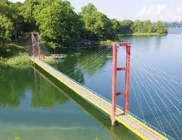
Picture showing:

Slide 7
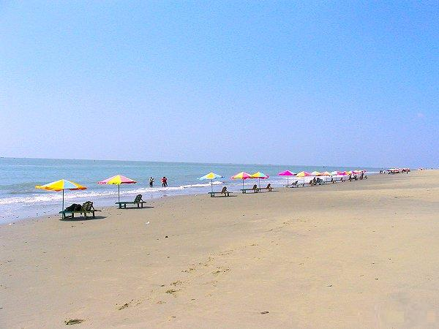

Slide 8
Lesson tittle:
My country.
Lesson unite:
There are …………country very much.

Slide 9
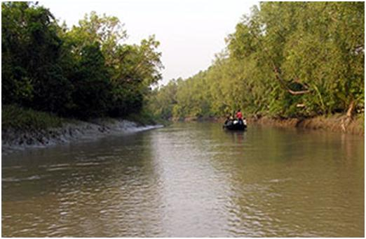
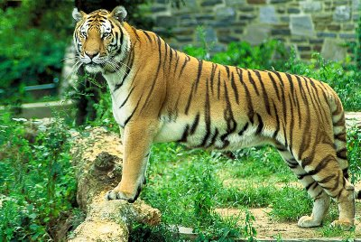
What can you see in the picture ?
Sundarbans

Slide 10
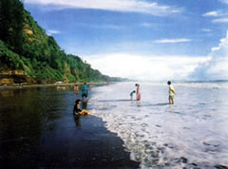
What can you see in the picture ?
Cox bazar sea beach

Slide 11
Students silent reading:

Slide 12

SAY THE RIGHT ANSWER: [W.C.W ]
1.What is the name of the longest sea beach in the world?
2.Where does the Royal Bengal tiger live ?

Slide 13
Fill in the blanks :[S.G.w]
1.We have many ………. Places.
2.CoxBazar beach is about
………K.M. long.

Slide 14
Make sentence:
Interesting-
Beach-
Sundarbans-

Slide 15
Write 5 sentence about your country.

Slide 16
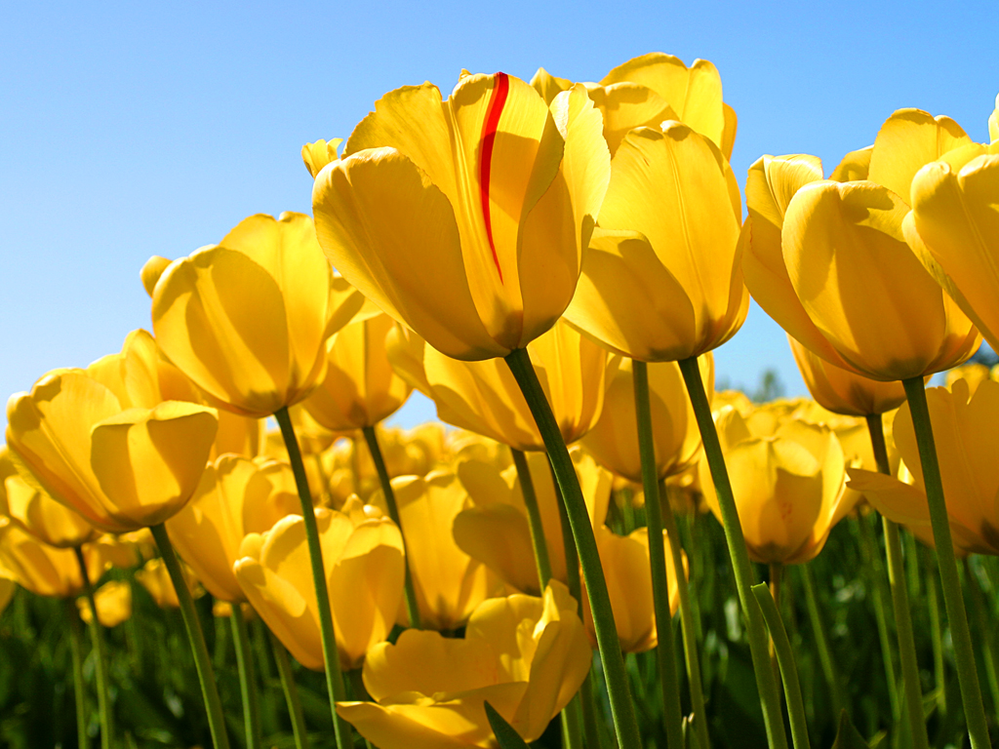
Good bye.
Thanks for all.

